Slide 1

Department of Computer Sciences and Engineering
B.Tech CE (AI)(Sem 7)
SpeedTix Chatbot –A Ticket Booking Chatbot
Presented By
Roshan Patel(12248)
Dhruti Patel(12295)
Guided By
Ms. Twinkle Patel

Slide 2
Introduction
Background:
Visitors face long queues, errors, and inefficiencies in manual ticket booking systems.
Negative impact on visitor experience and reputation.
Objective:
To develop an efficient chatbot-based system that eliminates manual booking challenges.

Slide 3

Literature Review
1) Research Findings:
Chatbots improve user satisfaction in booking systems (e.g., Smith et al., 2018).
JavaScript libraries like Flatpickr enhance interactivity.(Patel, V., & Mehta, R. (2019)
AI-driven chatbots improve engagement by reducing complexity.(Nguyen, L., & Wong, J. (2020)
2) Technological Insights:
Real-time response and adaptive user interactions are critical.(Singh, R., & Kaur, P. (2021).

Slide 4
Modules and Functionalities
1. Modules:
Chatbot Interface: Manages user interaction and guides the booking process.
Event Selection: Lets users choose event types, venues, and schedules.
Payment Verification: Secures transaction by verifying a 12-digit transaction ID.
Ticket Generation: Creates a digital ticket with details and a QR code.
2. Functionalities:
Seamless navigation from event selection to ticket generation.
Dynamic response based on user preferences.

Slide 5
Tools/Technology for Implementation
1) Technologies Used:
Front-End: HTML, CSS, JavaScript
Libraries: Flatpickr (date-time picker), html2canvas (ticket image generation)
2) Purpose:
HTML/CSS/JS: Create an interactive and responsive interface.
Flatpickr: Simplify date and time selection.
html2canvas: Generate downloadable ticket images.

Slide 6
Software Development Model
1) Development Approach:
Iterative development cycle.
2) Purpose:
Front-End Design: Responsive and user-friendly interface.
Chatbot Logic Implementation: User interaction and response handling.
Testing and Adjustment: Ensuring smooth functionality and fixing errors..

Slide 7
Project Planning
1) Phases:
Interface design and layout creation.
Integration of chatbot logic with interactive features.
Testing for error handling and functionality.
2) Milestones:
Completion of the chatbot interface.
Successful payment verification.
Deployment of the final ticket generation module.

Slide 8
Data Dictionary
1) Fields:
User Name (String): Identifier.
Event Type (String): Type of event selected.
Transaction ID (String): 12-digit ID for payment verification.
Booking ID (String): Auto-generated unique identifier.
2) Constraints:
Mandatory fields, valid formats, and uniqueness.

Slide 9
Test Cases
1) Tests Conducted:
Chatbot response validation.
Secure transaction processing.
Accurate ticket generation (with QR code).
2) Outcomes:
97% test accuracy.
98% successful transaction rate.
3) Examples:
Input: “Book a concert ticket.”
Expected Outcome: Event selection options.

Slide 10
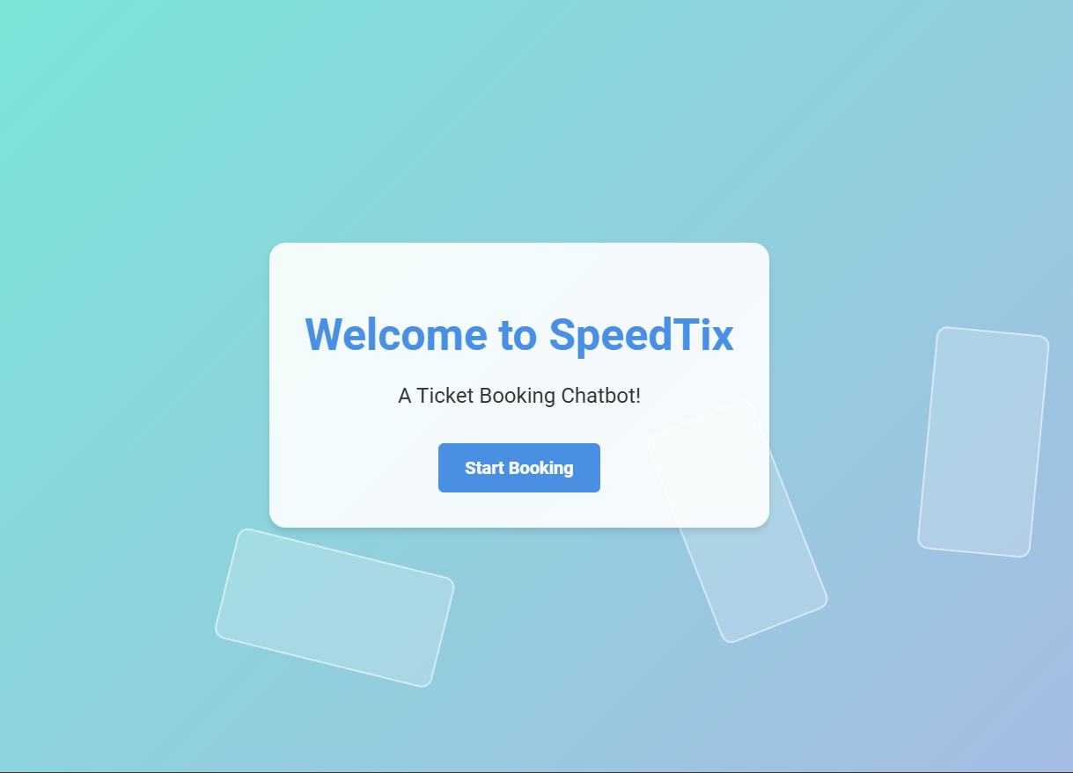
Implementation Snapshots
Welcome Interface

Slide 11
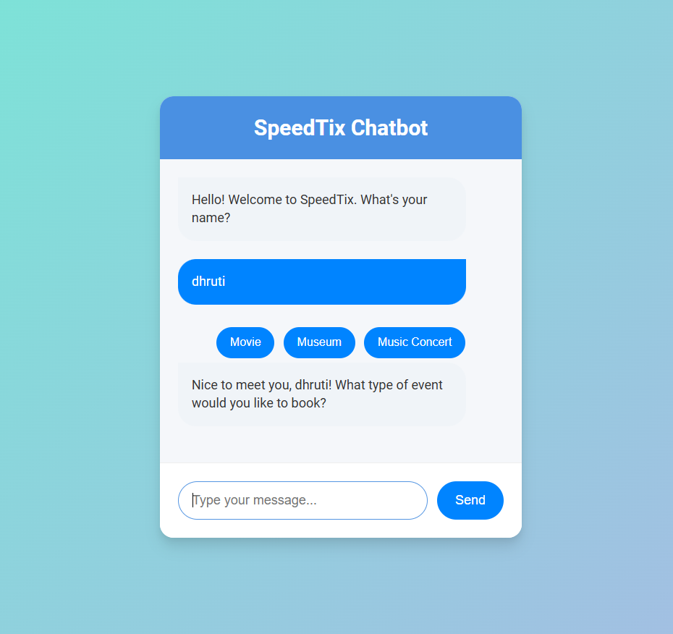
Implementation Snapshots
Chabot Interface

Slide 12
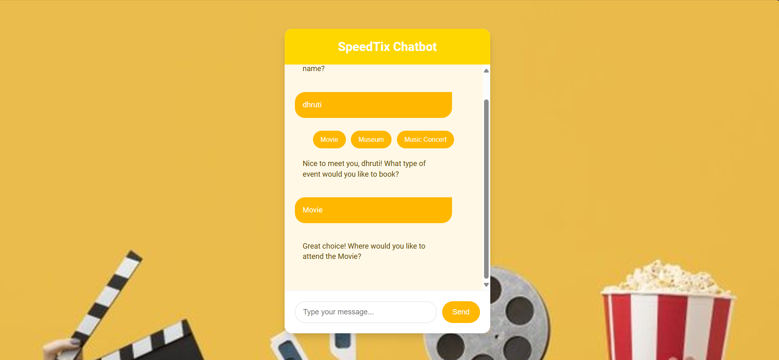
Implementation Snapshots
Movie Theme

Slide 13
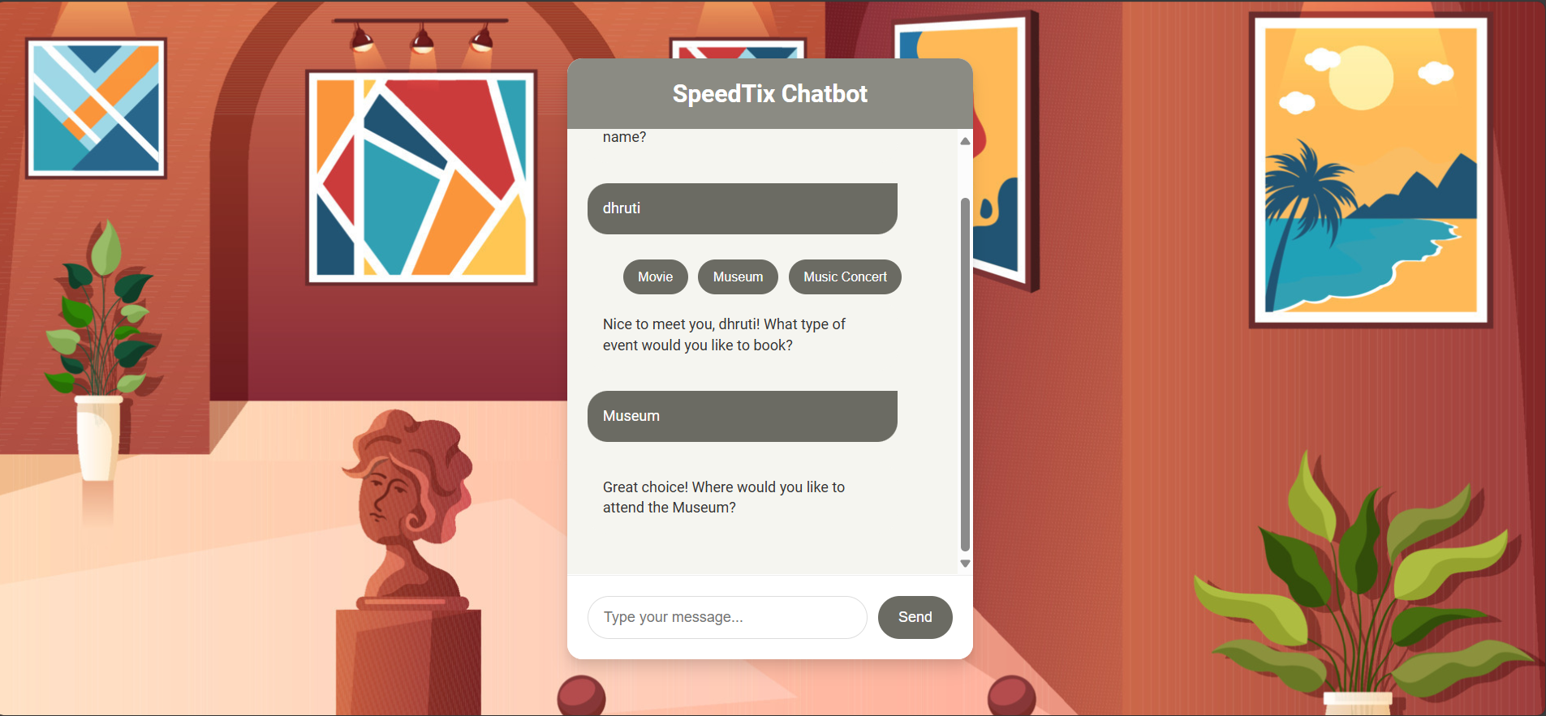
Implementation Snapshots
Museum Theme

Slide 14
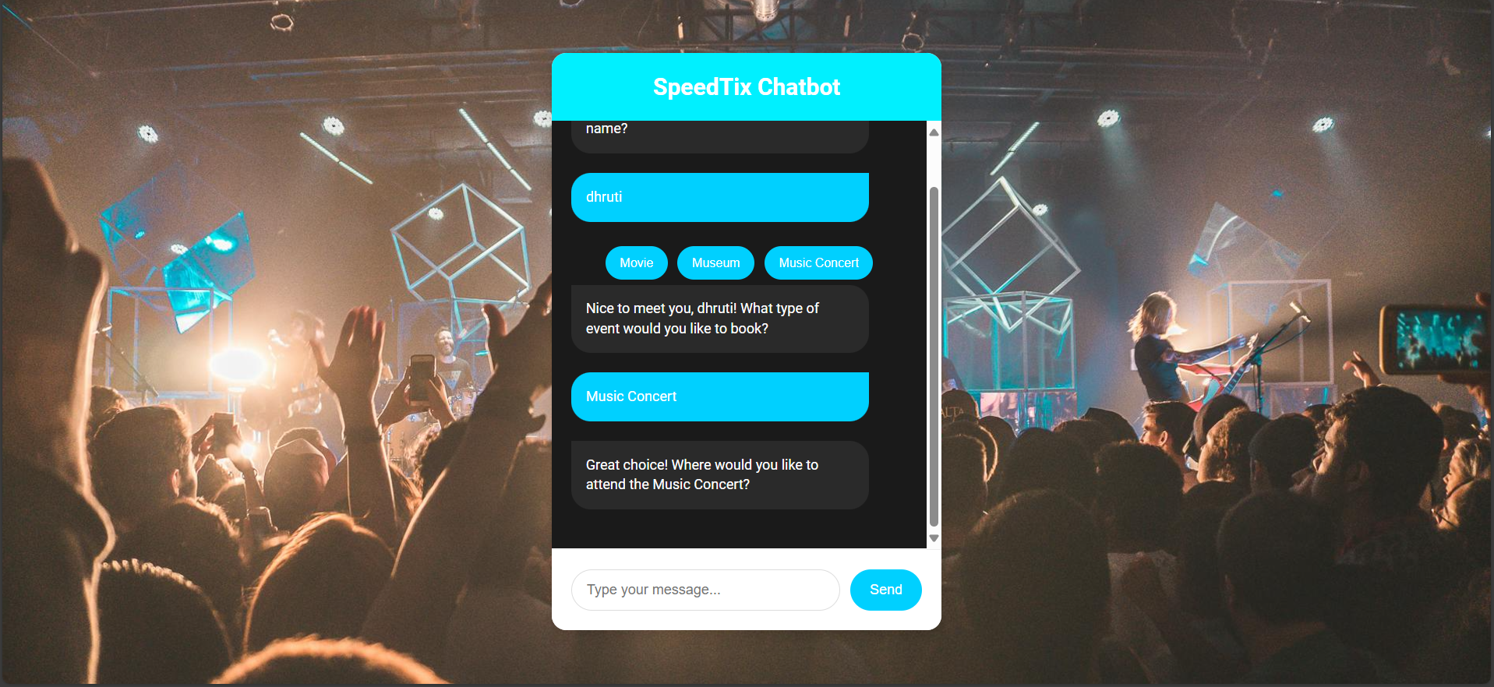
Implementation Snapshots
Music Concert Theme

Slide 15
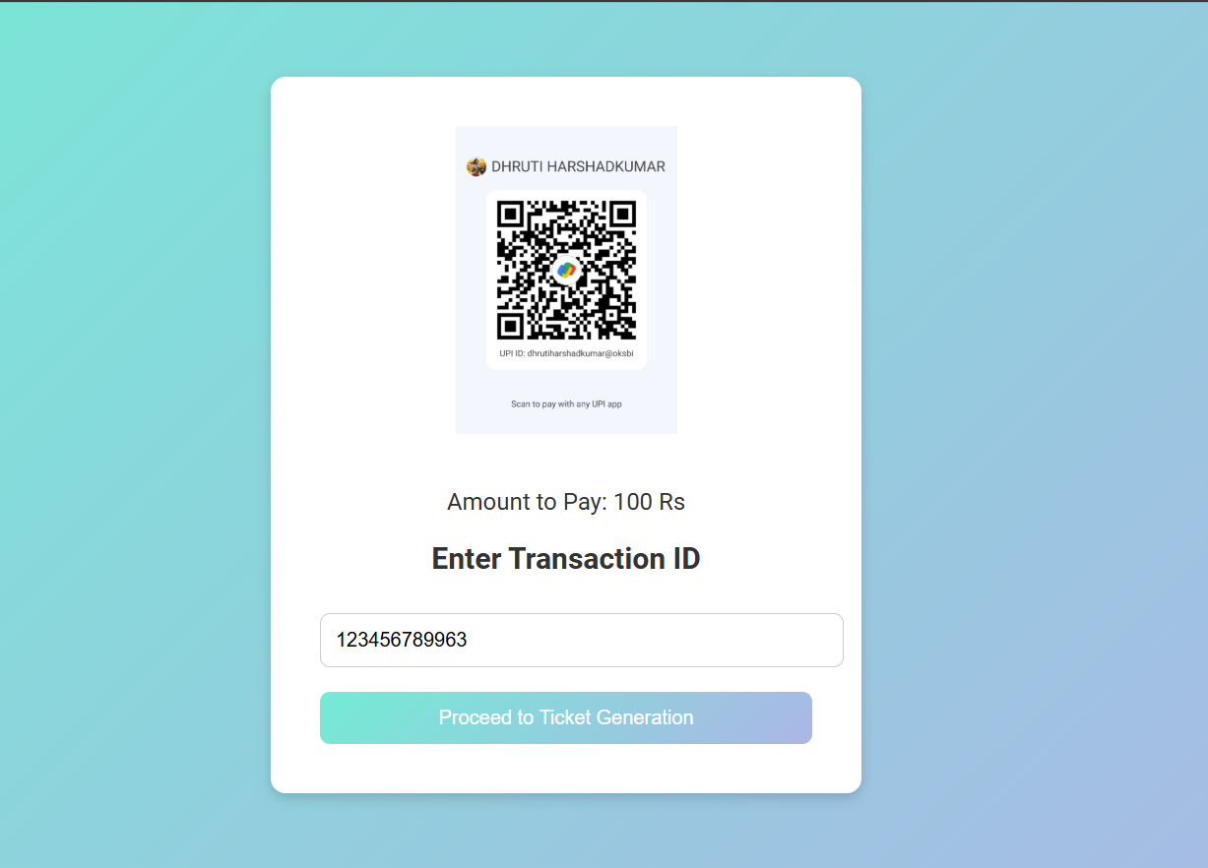
Implementation Snapshots
Payment Interface

Slide 16
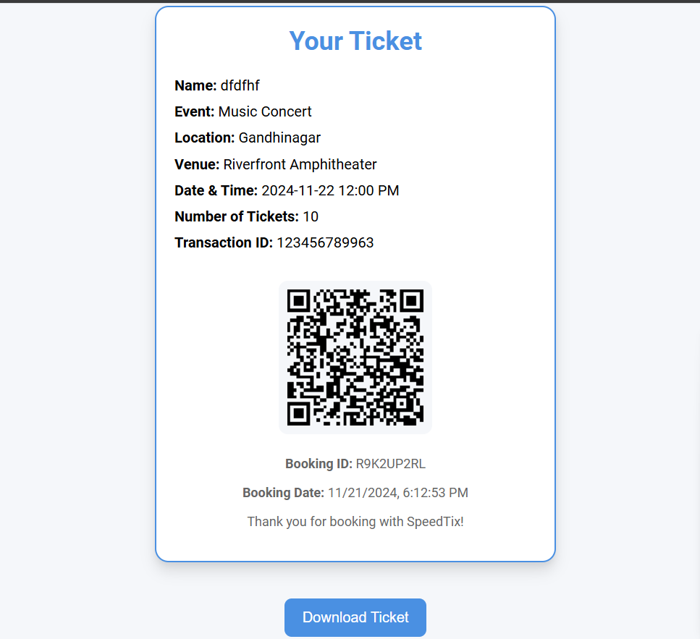
Implementation Snapshots
Ticket Interface

Slide 17
References
1) Vora, S., & Patel, K. (2020). Chatbot-based ticket booking system for event management. International Journal of Computer Applications, 182(11), 24-29. doi:10.5120/ijca2020915632.
2) Kumar, P., & Gupta, N. (2019). Development of a smart chatbot for ticket reservation using AI. Proceedings of the International Conference on Artificial Intelligence and Machine Learning, 1519.doi:10.1109/ICAIAM.2019.1012314.
3) Lee, J., & Park, H. (2021). AI-powered conversational agents for automated ticketing services: A survey. Journal of Artificial Intelligence Research, 62(3), 123-136. doi:10.1613/jair.2019.88235.
4) Zhang, Y., & Wang, X. (2018). Conversational AI chatbots for travel and event ticket booking. Proceedings of the International Conference on Digital Marketing and Artificial Intelligence, 45-55. doi:10.1109/DMAI.2018.0048.

Slide 18
THANK YOU!

